Slide 1
Predicting the likelihood of credit card churn
By Phong Pham

Slide 2
The problem
ABC Bank management is concerned with 16% of customers leaving their credit card services in 2020
The bank wants to find data-driven solutions to encourage customers to continue using their cards.

Slide 3
OBJECTives
To increase service level to customers who are most likely to churn on credit cards.
To encourage credit card utilization to keep churn rate below 10% by the end of 2021.

Slide 4
Strategies
Analyze demographics, banking and credit card usage details of more than 10,000 customers who have used at least 1 credit card issued by ABC Bank.
Find out the main reasons that lead to credit card churning and come up with possible solutions to reduce churning rates.

Slide 5
Data information
Dataset downloaded from: Credit Card customers | Kaggle
File format: CSV
10,120 records and 21 columns, each records represents a customer
9 data columns are numerical columns, the rest are categorical.
Target variable is Attrition Flag, which is a categorical variable

Slide 6
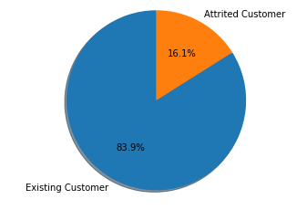
Data exploration: Class imbalance
Only 16.1% of all customer have churned on their credit cards.
Might lead to prediction inaccuracies with too many false negatives (i.e. actual churners but labeled as “not churn”)

Slide 7
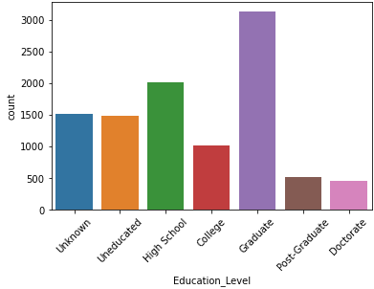
Data Exploration: Education level
The number of people who have graduate degrees is the highest, followed by high school degree holders
A considerable number of customers did not report their education level

Slide 8
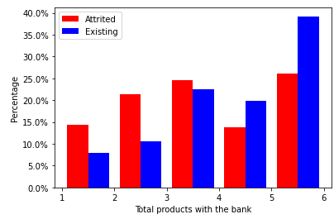
Data exploration: number of bank products
Customers who have 4 with the bank are least likely to churn on their credit cards.
People with 5 products account for the highest percentages of both “churned” and “not churn”

Slide 9
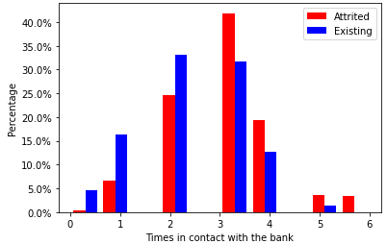
Data exploration: contact frequency
Customers contacting the bank 3 or more times will be more likely to churn on their cards.
They might not happy about regarding a product offered by the bank.

Slide 10
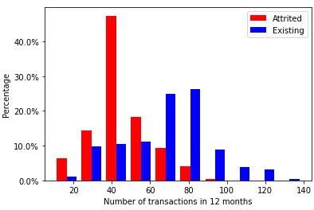
Data exploration: Transactions
Attritted customers are more likely to use their cards less often (60 times or fewer in 12 months).

Slide 11
Machine learning: PreProcessing Steps
One-hot encoding for categorical variables
Scaling numerical variables to a range between 0 and 1
Oversampling the minority class (Attritted Customers) using SMOTE to have a balanced dataset of 50% of each class
Split data into training and testing sets (with a 75:25 ratio)

Slide 12
Machine learning: Modeling
The following classification algorithms were used
Logistic Regression
K-Nearest Neighbor (KNN)
Support vector machine (SVM)
Random Forest
Gradient Boosting
Accuracy, recall, cross validation scores were used to evaluate each model

Slide 13
Machine learning: Modeling
Algorithm | Accuracy | Recall | CV test score
Logistic Regression | 0.8545 | 0.8538 | 0.9272
K-Nearest Neighbors | 0.8437 | 0.9678 | 0.8747
SVM | 0.9009 | 0.9101 | 0.9449
Random Forest | 0.9602 | 0.9546 | 0.9865
Gradient Boosting | 0.9569 | 0.9484 | 0.9864
Random Forest and Gradient Boosting yielded the best accuracy and CV test scores
Hyperparameter tuning done on these 2 methods using randomized cross validation

Slide 14
Machine learning: Modeling
Results from using optimal parameters for Random Forest and Gradient Boosting
Algorithm | Accuracy | Recall | CV test score
Random Forest | 0.9642 | 0.9612 | 0.9892
Gradient Boosting | 0.9653 | 0.9574 | 0. 9918
The fewer false negatives the better the prediction model
➔ Random Forest should be used for future predictions

Slide 15
Conclusions
21 original features were engineered into 29, all of which were used in predicting the attrition flag
Random Forest provided the best results out of 5 supervised classification models

Slide 16
Solutions
Running the Random Forest model every month to find out if any existing customers are flagged as potential churners
Contact these customers to get feedback on the credit cards they own and the experience with the bank
Customize promotions for each group of customers

Slide 17
Limitations and future actions
Data was taken only in the last 12 months
➔ Useful to incorporate data from at least another year for training the model
Many records lack demographic details (Unknown education level, income, marital status)
➔ Reach out to customers to update these details

